Slide 1
Modern Airships
Euro Airship
10 times less Co2 emissions than aircrafts
Freight and Passenger Capabilities

Slide 2
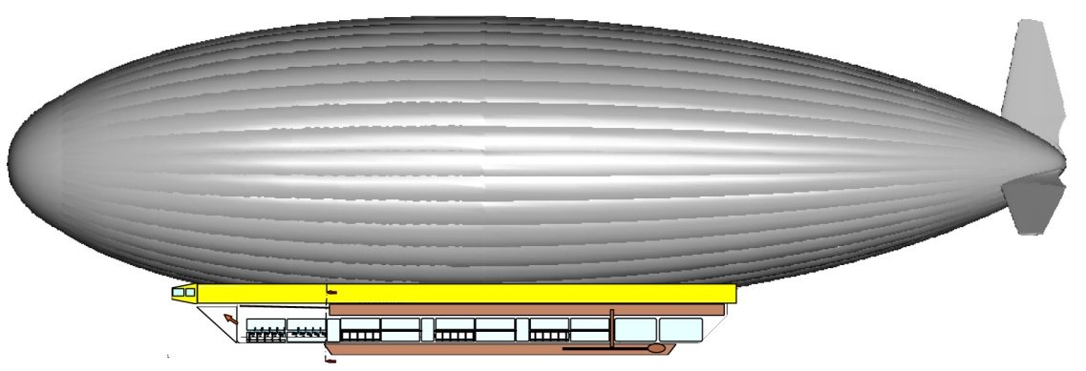
Side View

Slide 3
Specifications
Length 169 m
Height 45 m
Helium Capacity 98 000 m3
Payload 25/30 T
Model DGPA
Engine: Turbines 4 TURBOMECA RTM 322 de 2580 shp
Maximum speed: 130 / 140 km/h
Cruising speed 110 km/h
Crew : max. 10 : 1 pilot,1 co-pilot et 8 crew members
Maximum passengers: 180
1 Lounge 20 seats, restrooms, changing rooms etc…

Slide 4
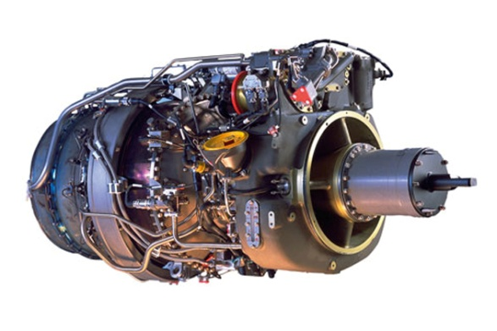
Engine Specifications
RTM 322
Power 2580 shp
Weight 503 lb
Compression 3HP+1CFHP
Pressure Ratio 16/1
Diameter 638 mm
Consumption 220 ghph
Helicopter turbine; European NH 90,
NH 90, Apache, Sikorsky SH
Manufacturer:
Turbomeca, Rolls Royce

Slide 5
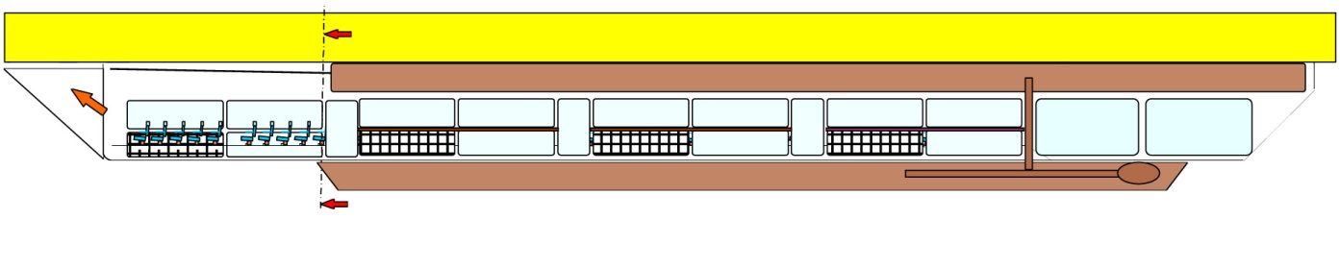
Access to control cabine
Technical room
Side View of the Panoramic Cabin

Slide 6
Standard Passenger Seat

Slide 7
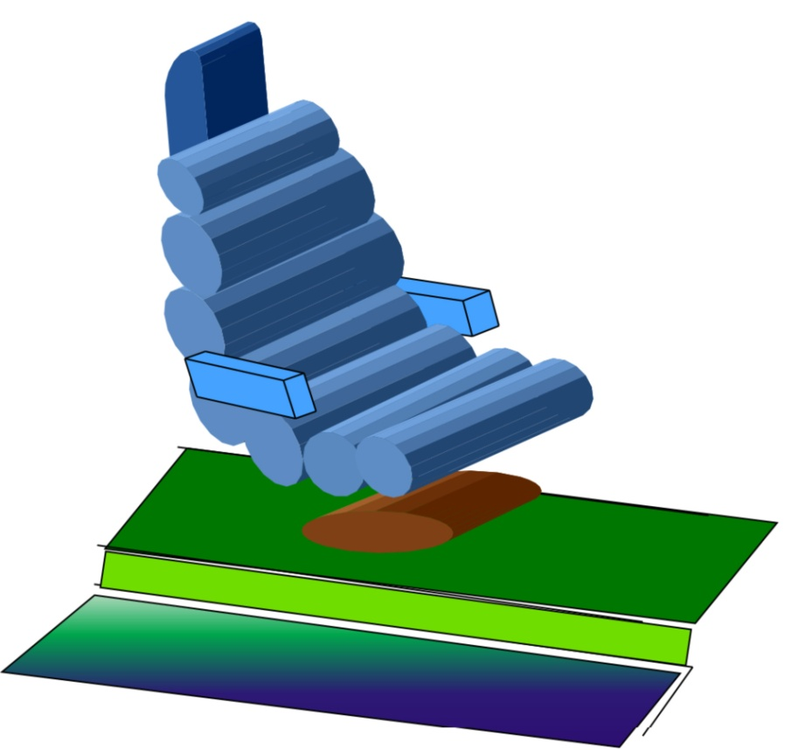
Individual seat

Slide 8
Seats Setting

Slide 9
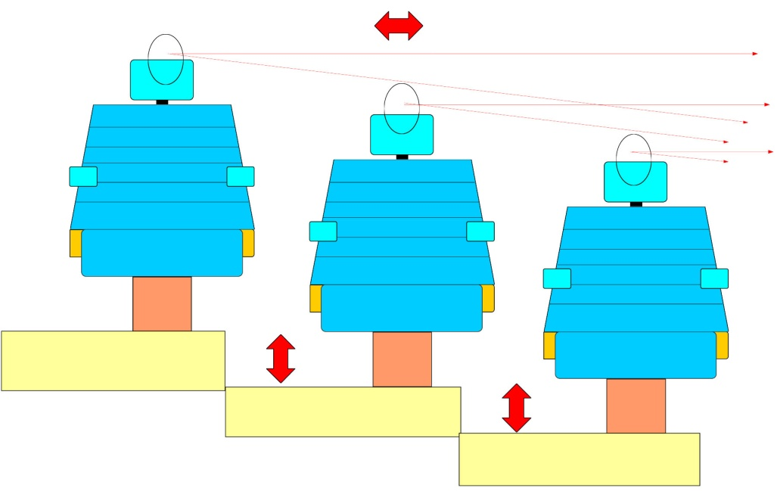
The setting up of the seats to enable passengers to have a full panoramic view for everybody.

Slide 10
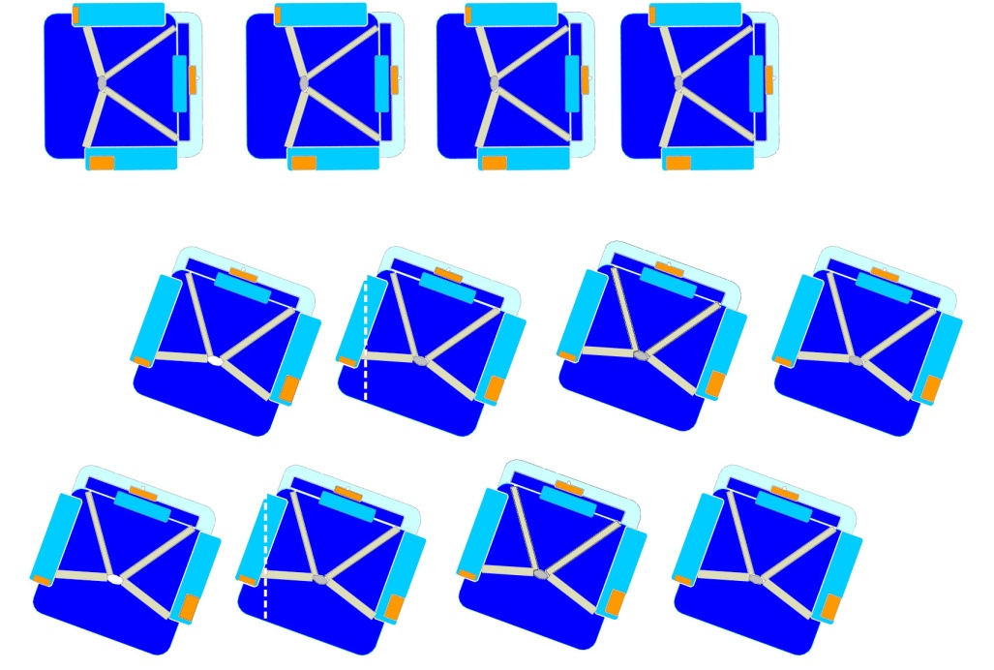
The seats are installed in such a way that enable great visibility for each passenger and enough space to move around the seats.

Slide 11
Folding Touchscreen control for pilot and co-pilot
Joystick
Swivel seat to access flight control instruments
Flight Deck

Slide 12
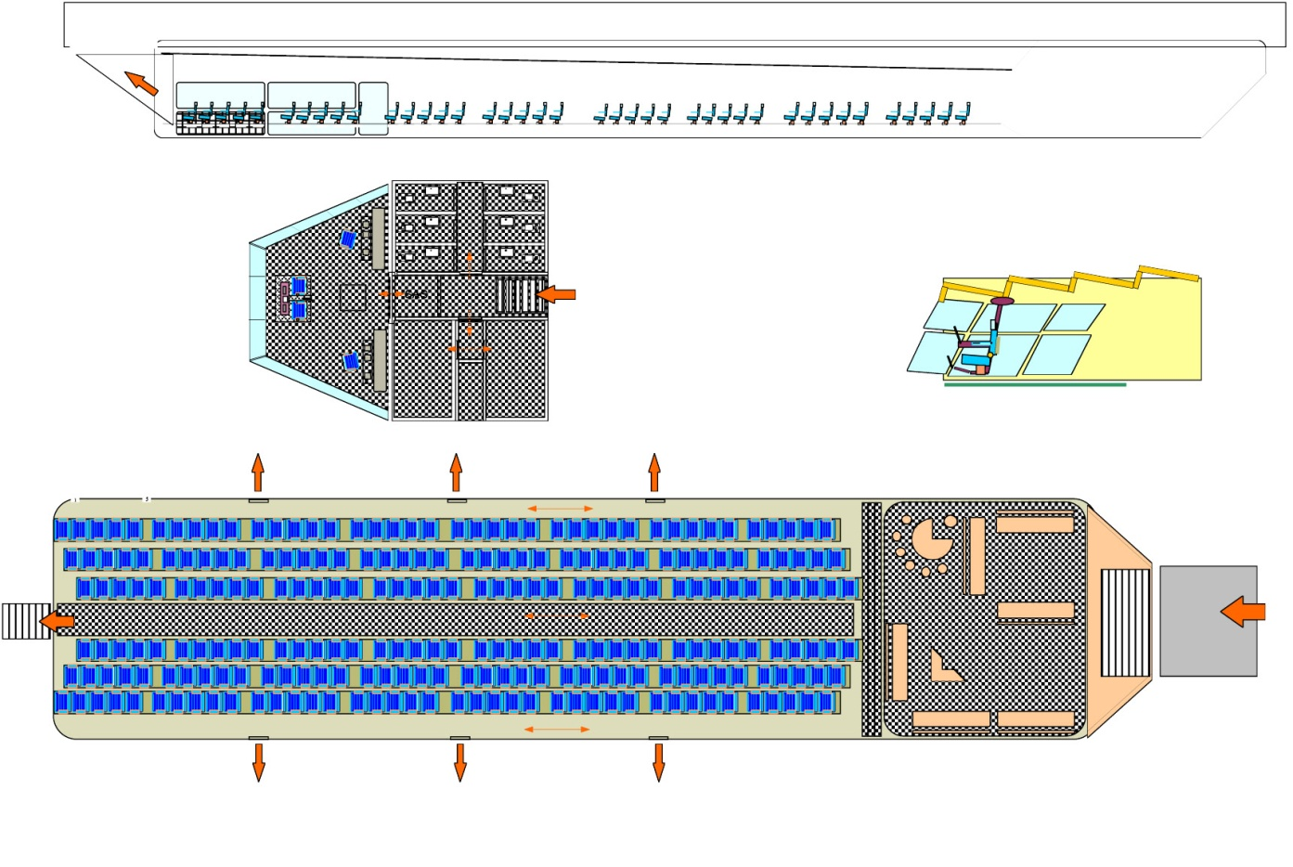
Flight Deck
Technical Room
Stairs to passenger restrooms and flight deck
Control Room Layout
Flight Deck Layout
Cabins reserved
For crew members
Bar & Lounge
Access Ramp
Lateral Exit & Emergency Exit
160 seats
Passengers Area

Slide 13
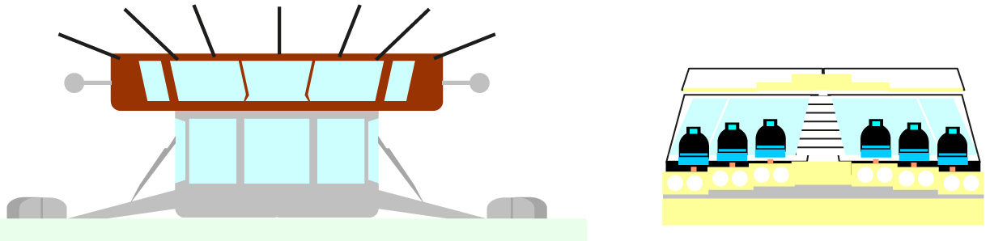
Front view of the cockpit, the front bay and a general section in the entire arrangement of seats
Cabin and engine rooms, steering front view. Outriggers allow the unit to make water landing

Slide 14
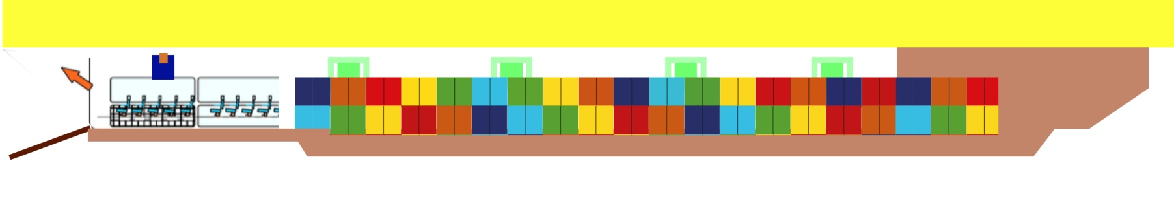
Container Gondola
Containers
Flexible gondola swaps between Passenger, bulk and Container freight as well as large irregular shape cargo such as power plants, oil rigs etc.

Slide 15
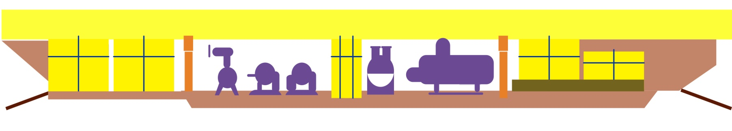
Bulk Cargo Gondola
Bulk Cargo

Slide 16
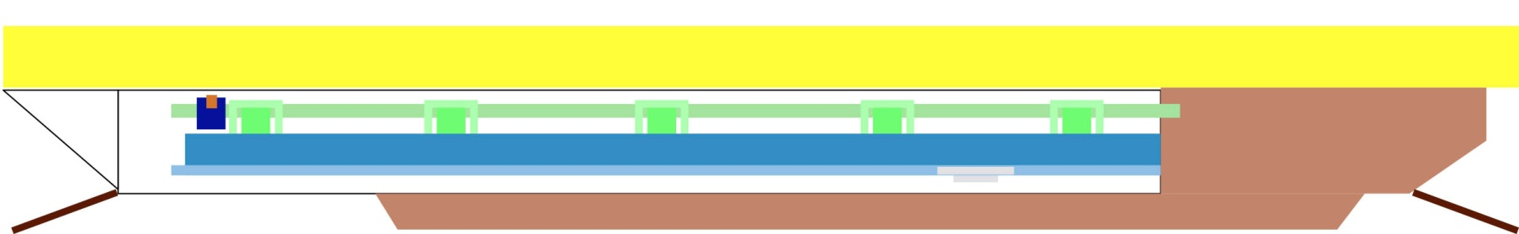
Irregular Shape Cargo Gondola
Irregular shape
Cargo

Slide 17
